Slide 1
Biofuels Careers
Unit 6, Lesson 1

Slide 2
Careers in Production of Inputs
Grain Accountant
Farmer
Seed Dealer
Equipment Dealer

Slide 3
Careers in Transportation of Materials
Logistics Manager
Truck driver

Slide 4
Careers in Ethanol Processing
General Manager
Production Supervisor
Lab Manager
Materials Handler
Production Operators
Chemical Engineers
Handler

Slide 5
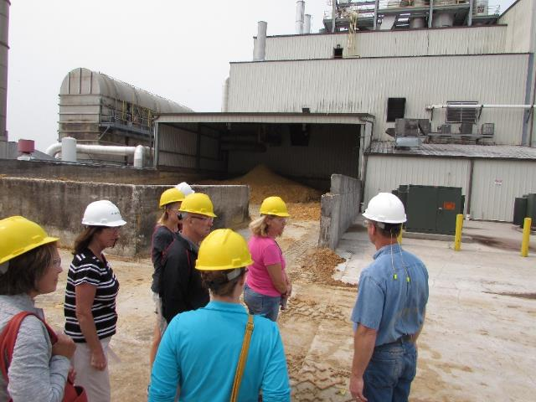
Careers in Production and Maintenance of Facilities
Project Leader
Electricians
Mechanical Technicians
Maintenance Technicians
Mechanical Engineers
Civil Engineers

Slide 6
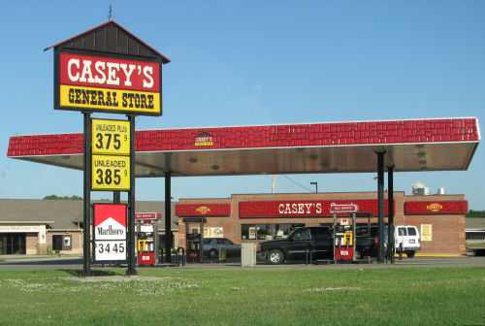
Careers in the Distribution of Ethanol
Product loading
Ethanol Stations

Slide 7
Careers in the Marketing/Clerical/Industry Support
Environmental Health and Safety Coordinator
Auto Dealerships
Auto Technicians
Equipment (mechanical)
Engineer
Secretary
Accountants
Lawyers
Payroll
Clerks
Attorneys

Slide 8
Do biorefineries provide jobs in Iowa communities?

Slide 9
What is a Career Pathway?
Career Pathways are a workforce development strategy used in the U.S. to support workers’ transitions from education into and through the workforce.
This strategy has been adopted at the federal, state and local levels in order to increase education, training and learning opportunities for America’s current and emerging workforce.
A career pathway groups careers related together by related fields and similar characteristics.
The employment requirements require common interests, strengths, and competencies.

Slide 10
Educational Pathway
Career Pathway
Entry-level Trainings/Certifications
Boiler License
General Agriculture Training
Welding
Associate’s Degree Majors
Agriculture
Electrical Construction & Control
Ethanol Production & Management
Electromechanical
Industrial Technology
Bachelor’s Degree Majors
Accounting
Agriculture
Business Management
Chemistry/Microbiology
Industrial Technology
Marketing
Jobs Requiring Training and/or Certification
Assistant Operators
Assistant Boiler Operators
Commodity Handlers
Maintenance
Warehouse/Receiving Clerk
Jobs Requiring an Associate’s Degree
Boiler Operator
Electrician
Grain Merchandiser
Human Resources Director
Lab Assistant
Maintenance Manager
Safety Officer
Team Lead Operator
Jobs Requiring a Bachelor’s Degree
Accountant
Commodity Marketing Director
Environmental Specialist
Lab Manager
Plant Manager
Safety Officer

